Slide 1
Electrochemical Cells T.Y.B.Sc. Physical Chemistry CH-501 Dr. Gunvant H. Sonawane Department of Chemistry, Kisan Arts Commerce and Science College, Parola Dist Jalgaon, MS, 425111 Email: drgunvantsonawane@gmail.com

Slide 2
CH-501
Subject- Principles of Physical Chemistry-I
UNIT- 4. Electrochemical Cell (L-12, -M15)
Introduction,
Oerview of electrode processes,
Faradaic and non-Faradaic Processes,
Introduction to electrical double layer,
Factors affecting electrode reaction rate and current.
Classification of electrochemical cell,
EMF expression for chemical cell with and without transference,
Liquid junction potential,
Types of liquid junction potential,
Minimization of liquid junction potential.
Application of EMF measurement for pH using
Hydrogen gas electrode, Quinhydrone electrode and Glass electrode,
Related numerical.
Ref. 5: 1-4, 9, 10, 12-14, 23, 24, 64, 72, 73, 74
Ref. 4: 807, 808, 811, 812, 816-818

Slide 3
Cell : Electrode or Half Cell : Battery:
Anode
-ve
Oxidation
Loss of Electron
RHS
Increase in +ve oxidation state
Decrease in –ve oxidation state
M_{(s)}/M^{n+}
Cathode
+ve
Reduction
Gain of Electron
LHS
Decrease in +ve oxidation state
Increase in –ve oxidation state
M^{n+}/M _{(s)}

Slide 4
Types of Cell
Electrolytic Cell
Electrical energy converted to chemical energy
Electrical energy is consumed
Connected to Battery
An input of energy is required for the redox reactions to proceed in these cells, i.e. the reactions are non-spontaneous.
Electrolysis of electrolyte takes place
Anode +ve, Cathode -ve
Electrons originate from an external source (such as a battery).
Electrolysis of fused NaCl, Electrolysis of aqueous NaCl
Decomposition of water into H₂and O₂
Electroplating of Cu, Ag, Ni, Au, Cr
Electrolysis of aqueous CuSO_{4 or} fused CuSO₄
Electrochemical Cell
Galvanic cell or Voltaic cell
Chemical energy converted to electrical energy
Electrical energy is generated
Redox reactions that take place in these cells are spontaneous in nature
Connected to galvanometer
Electrolysis does not takes place
Anode –ve, Cathode +ve
The electrons originate from the species that undergoes oxidation.
Daniel cell, Dry cell, Lechlanches cell

Slide 5
Electrodes
o anode, oxidation
o cathode, reduction
Half-cell
o one container, electrode, and solution
Salt bridge
o conducting medium through which ions can move from
one half-cell to the other half-cell
o this is electrolytic conduction (the movement of ions
carrying electrical charge)
o contrast with metallic conduction (electrons through wire)
Ion migration
o anions migrate towards the anode
o cations migrate towards the cathode
Conduction of

Slide 6
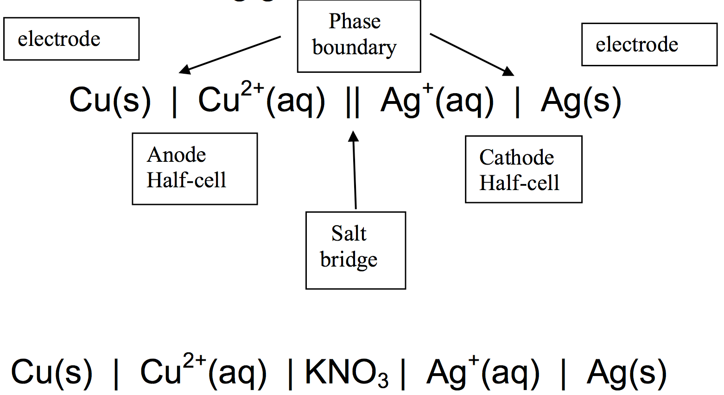
Cell Notation (shorthand for describing a galvanic cell):

Slide 7
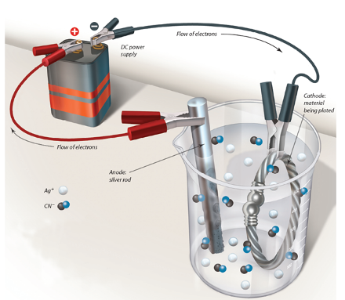
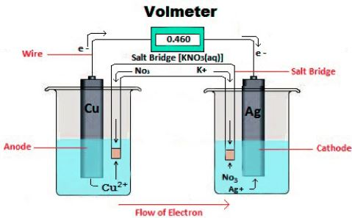
Electrolytic cell
Electrochemical Cell

Slide 8
Standard Reduction Potentials
Electrical current flows from the anode to the cathode due to a difference in electrical potential energy between the electrodes
This current is measured, in volts (V), by a voltmeter.
Measured current
called the overall cell potential (Ecell)
is the difference between the electrical potentials at the
two electrodes (the two half-cell potentials)
varies with concentration, temperature, metals/ions used.
Standard cell potential : The cell potential under standard state conditions, [ions] = 1 M, T = 25°C, 1 atm gas pressure.

Slide 9
Standard reduction potential (E° or E°red):
Reduction potential for a half-reaction under standard state conditions.
When two half-reactions are connected
the one with the larger (more positive) E°_{red} goes as a
reduction
the other one (less positive E°_{red}) goes as an oxidation
with E°_{oxi} = -(E°_{red})
E°_{cell=} E°_{oxi (anode)+} E°_{red(cathode)}
We can only measure Ecell so how do we get E°red and E°ox ?
We select a specific half-cell as our reference (defined as
zero) and then use this one to get E°red for all other half-cells.

Slide 10
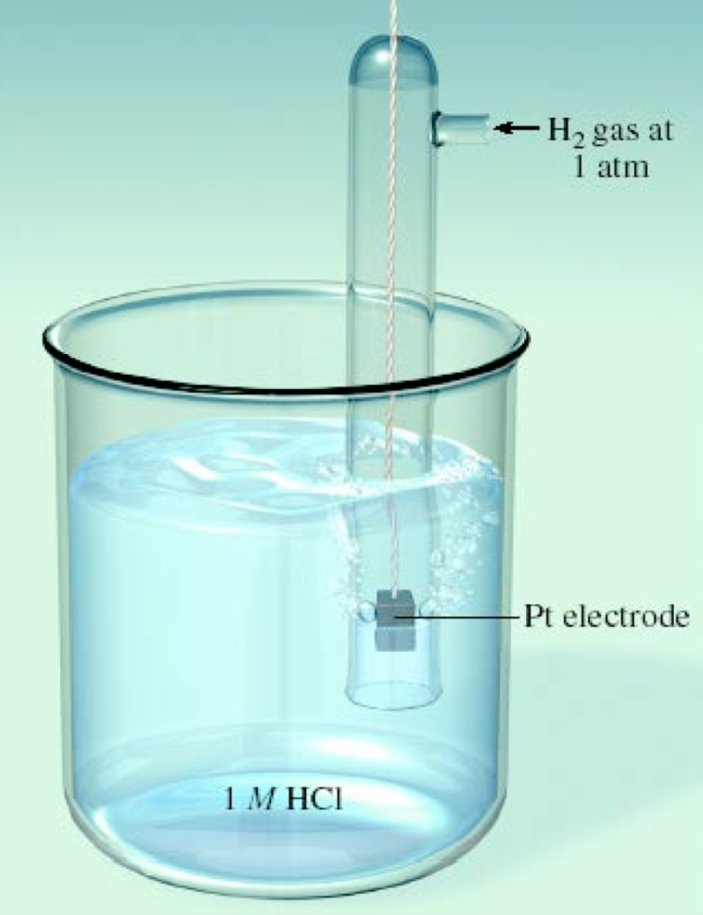
Reference half-cell : Standard Hydrogen Electrode (SHE)
standard state conditions
assigned a value of 0 V
reaction is 2H⁺_{(1 M)} + 2e– → H₂ (1atm)
E^{ο} _{H+/H2}= 0 V

Slide 11
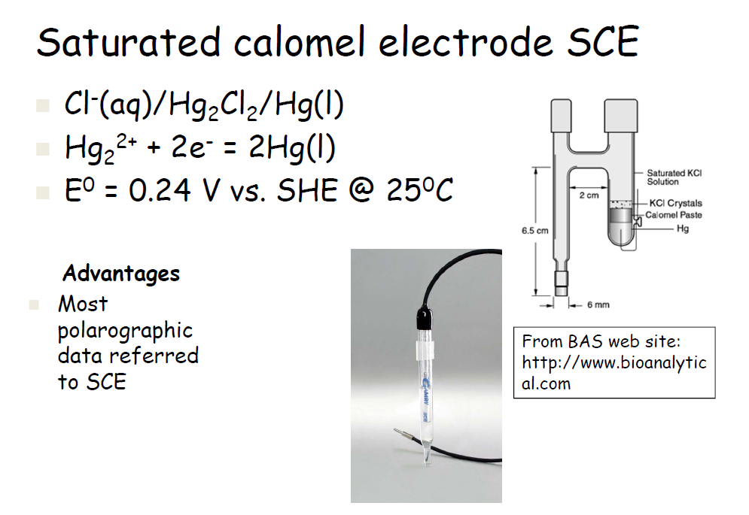
Reference Electrode-

Slide 12
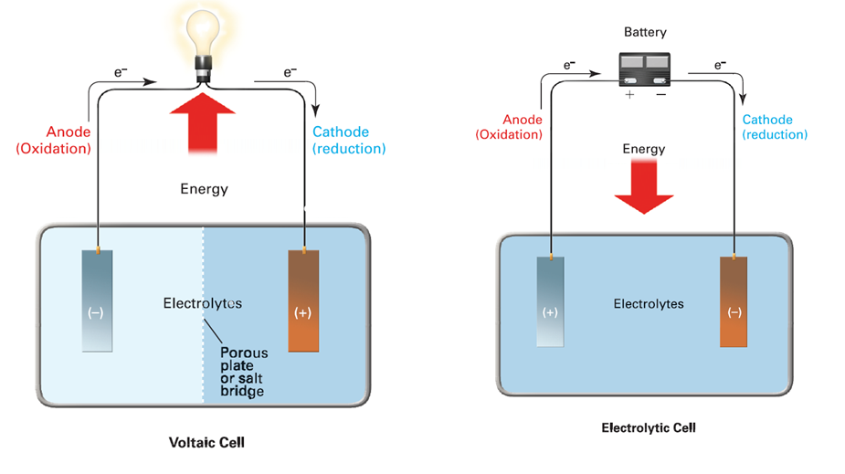
So what is the difference between the cells?

Slide 13
Electrochemical cell or Voltaic cells or Galvonic cell
These cells occur naturally or spontaneously
We will look at potentials to determine when a reaction is spontaneous but lets look at a cell first
Lets look at the reaction between zinc and copper.
Zinc and copper are electrodes
The zinc is in a solution of ZnSO₄
The copper is in a solution of CuSO₄
Anode Zn_{(s)} → Zn²⁺_{(aq)} + 2e^{- Oxidation}
Cathode Cu²⁺_{(aq)} + 2e⁻ → Cu_{(s) Reduction}

Slide 14
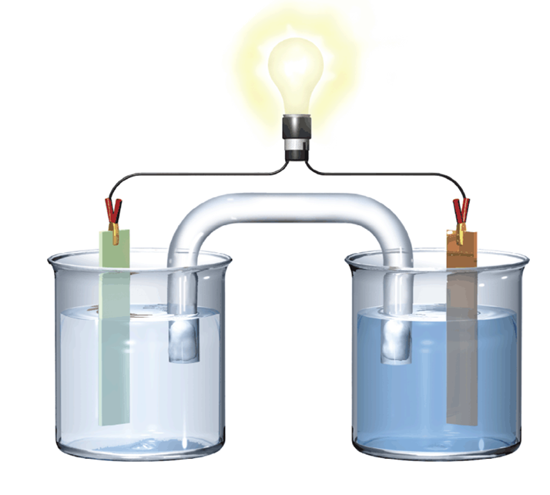
+
l
Copper
Reduction
Cathode
Zinc
Oxidation
Anode
SO₄²⁻
SO₄²⁻

Slide 15
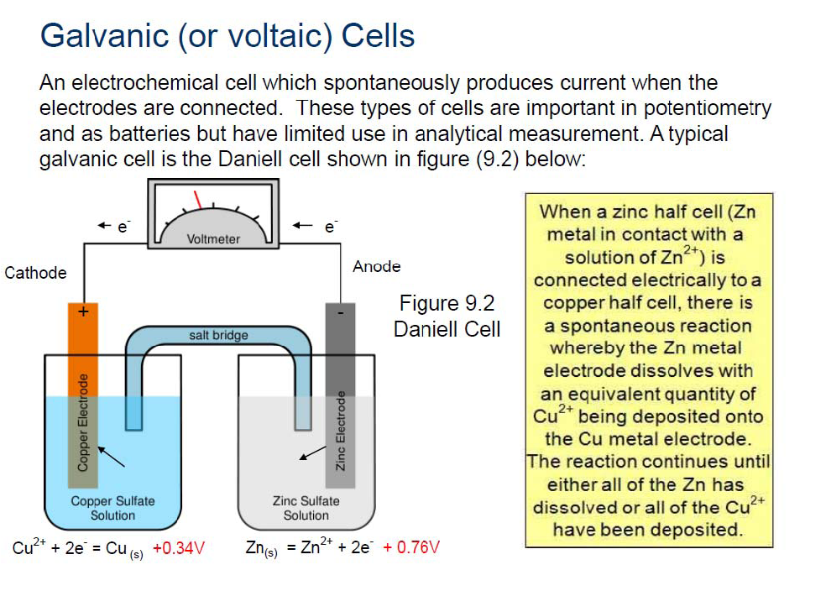

Slide 16
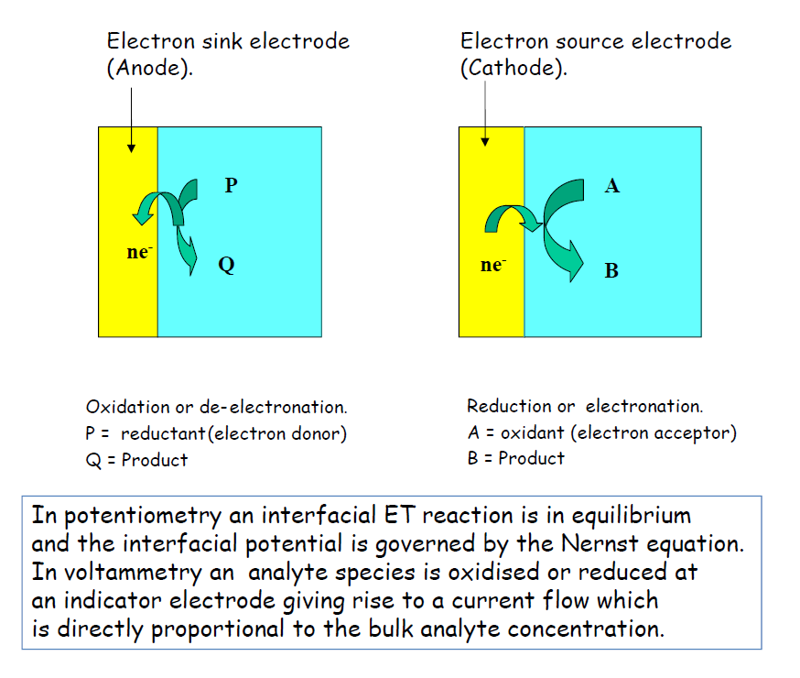

Slide 17
Reference Electrode-

Slide 18
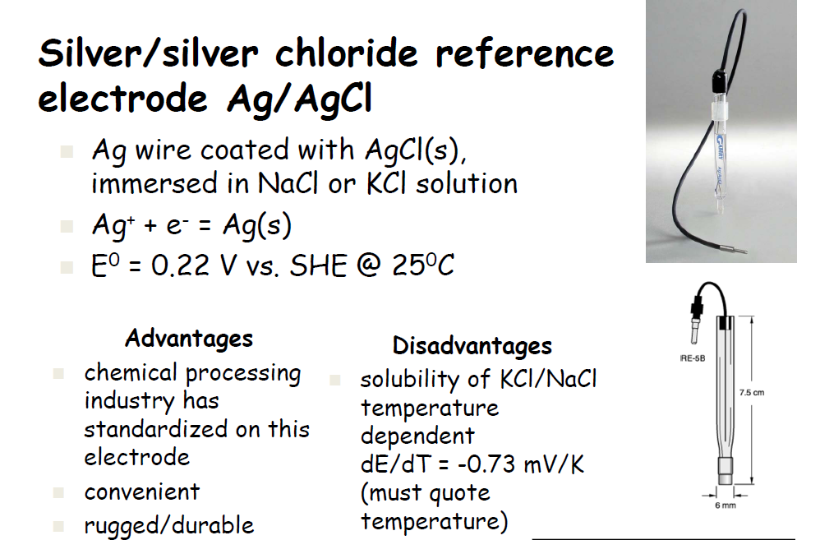

Slide 19
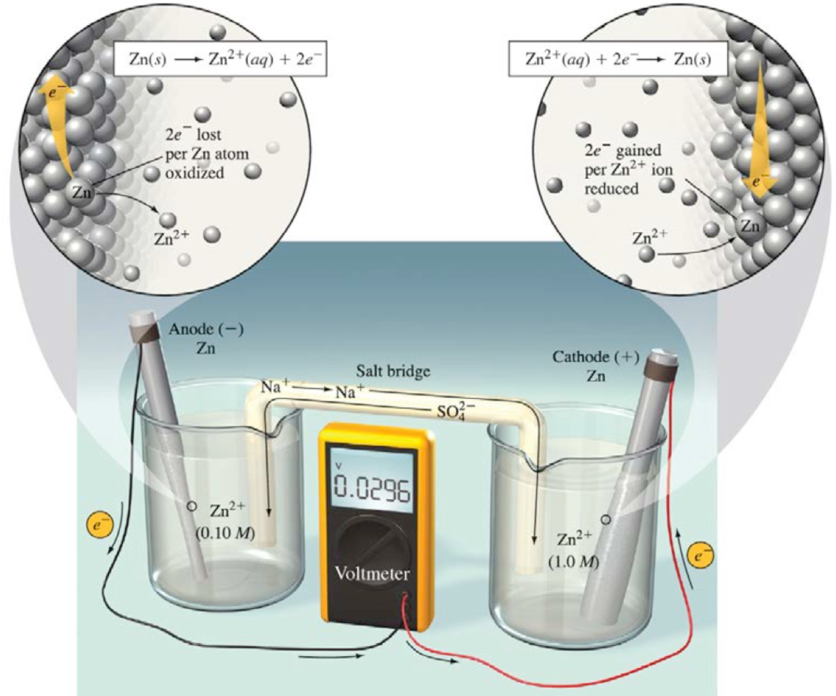
Concentration Cell : is a galvanic cell composed of the same material but differing in ion concentrations.

Slide 21
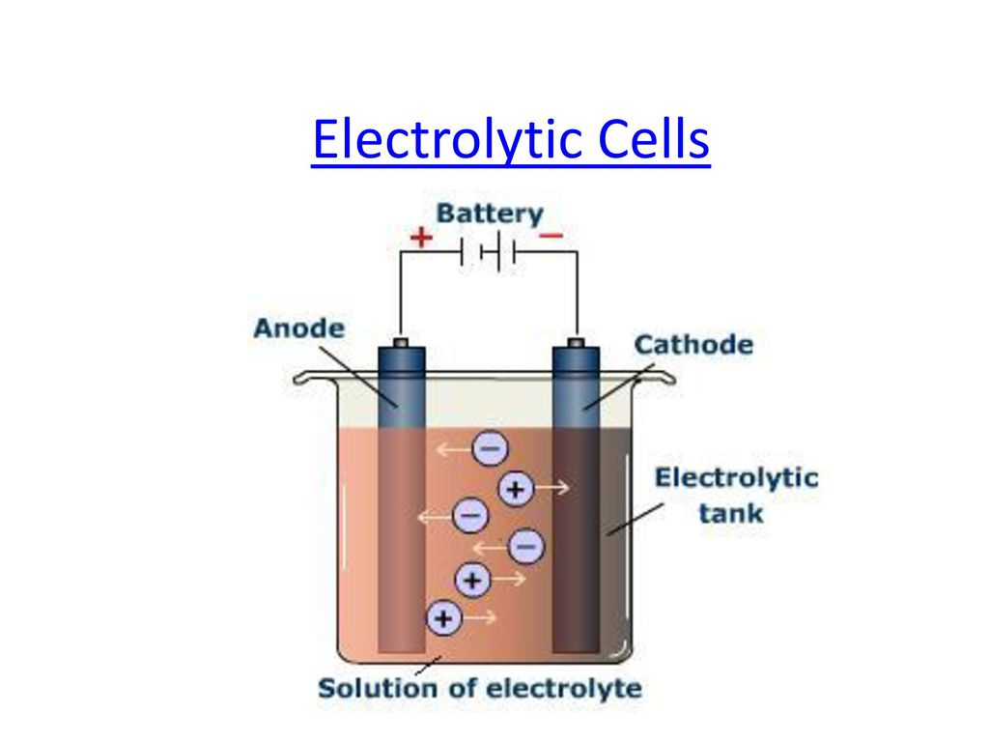
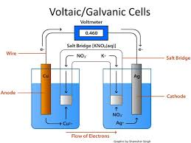
Both Galvanic and Electrolytic cells contain:
Two electrodes: the Anode and the Cathode (NOTE: Cathode does not mean +, and Anode does not mean -)
Volt meter: measures the electric current. In Galvanic cells, this shows how much current is produced; in Electrolytic cells, this shows how much current is charging the system.
Electrolyte
conducting medium
has contact with electrodes
usually in aqueous solution of ionic compounds

Slide 22
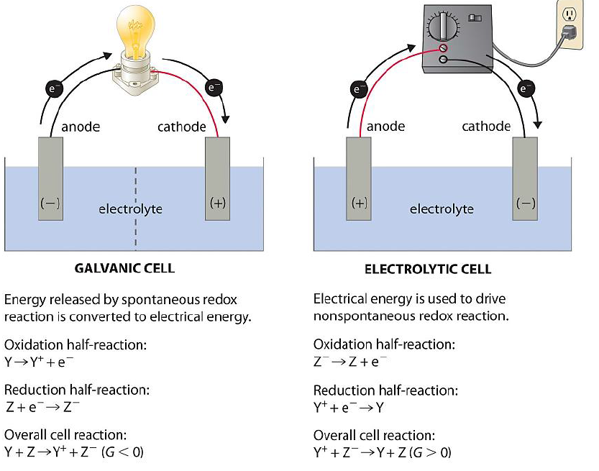

Slide 23
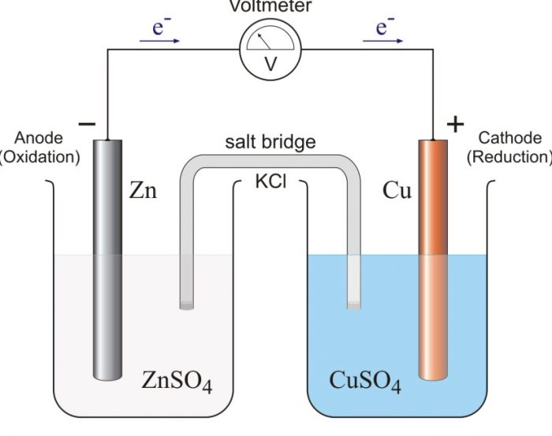
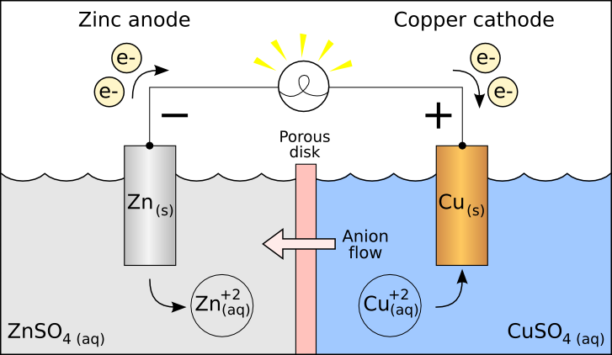

Slide 24
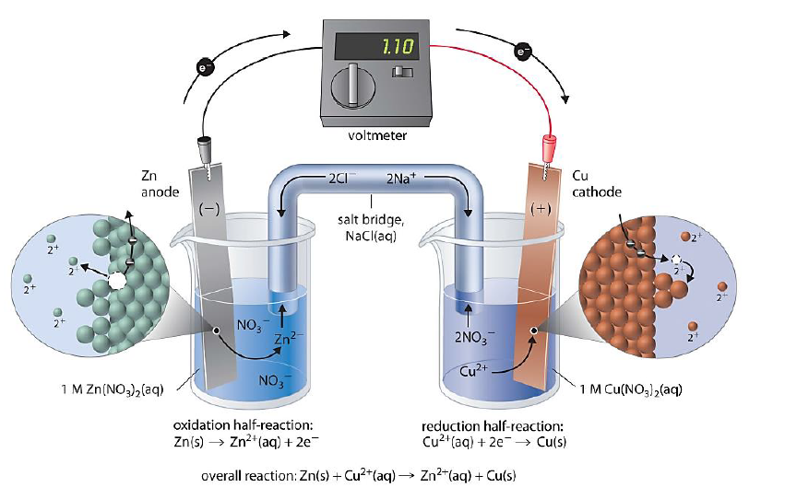

Slide 25
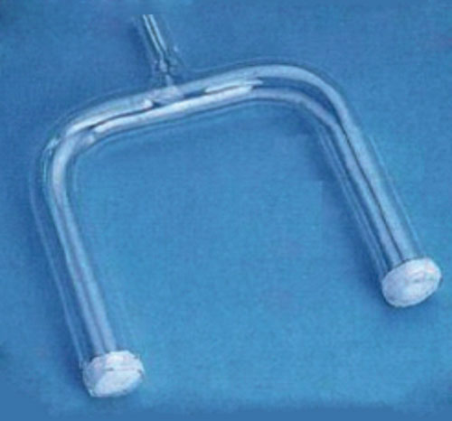
Salt Bridge
Functions of Salt bridge
joins the two halves of the electrochemical cell
filled with a salt solution or gel
keeps the solution separate
Completes the circuit

Slide 26
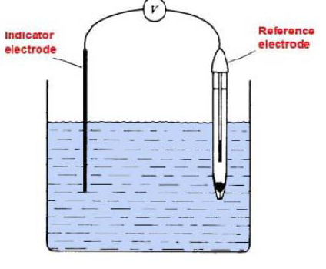
Basic Electrochemical Cell Two electrodes- Indicator electrode and Reference electrode

Slide 27
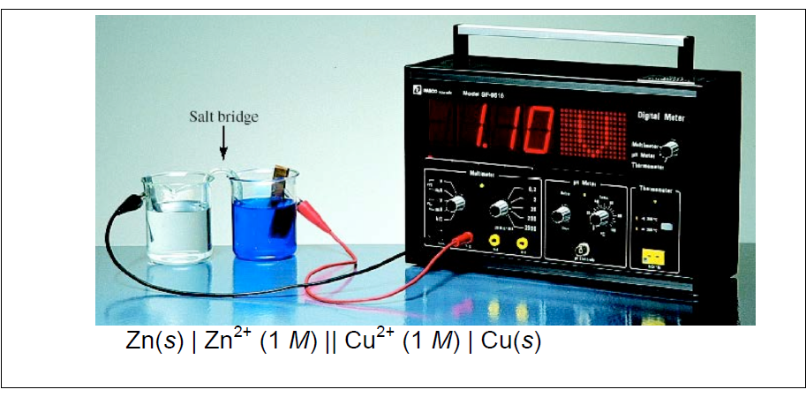

Slide 28
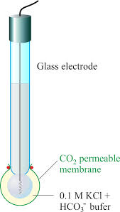

Slide 29
Glass electrodes are ion-selective electrodes based on the chemical properties of a glass membrane of defined chemical composition. Alteration of the glass chemistry to contain variable quantities of Na₂O, CaO, SiO₂, and Al₂O₃ produces chemically active binding sites in the glass that have hydronium, sodium, or simple cation selectivity. The construction of a typical electrochemical cell based on a glass electrode is shown in
The internal solution contains a fixed concentration of the cation of interest and therefore fixes the internal electrode surface potential, while that in the external solution varies. The electric potential develops only in each hydrated gel layer based on an ion-exchange principle that leads to a phase boundary potential. The entire glass membrane is nominally 50–100 μm in thickness, but the hydrated glass accounts for little of this, being only 5–100 nm thick. Conduction within the dry glass is due to the cation of lowest charge and is not related to penetration by a substantial amount of cations

Slide 30
Thank you

